Slide 1

NUMBER PLATE DECTION OF A CAR
User Manual
Author: Pratham Saxena
Notes:
Preworks course home assignments

Slide 2
Table of Contents
Acknowledgment
About me
My journey in this internship
About the app
How to use the app
App GUI
Contact

Slide 3
Acknowledgements
A small vote of thanks for all those who have helped me in this journey of App Development – first thanks to my parents , My Mentor ,Mr. Avishek Das , Dr. Ken and My Friends who gave me ideas and different resources that I used.

Slide 4

About Me..
Student’s Photograph
Introduction :
My name is Pratham Saxena , currently studying in 12th grade,
My reason to be a part of this journey is the curiosity I desire for this particular field.

Slide 5
About My Internship Journey with Clevered..
My journey with Clevered has been one of the best things, the whole journey was filled with interesting topics , new things to learn , how different thing work which are in our surroundings , I just so wish all my future have the same help and support that clevered has given me

Slide 6
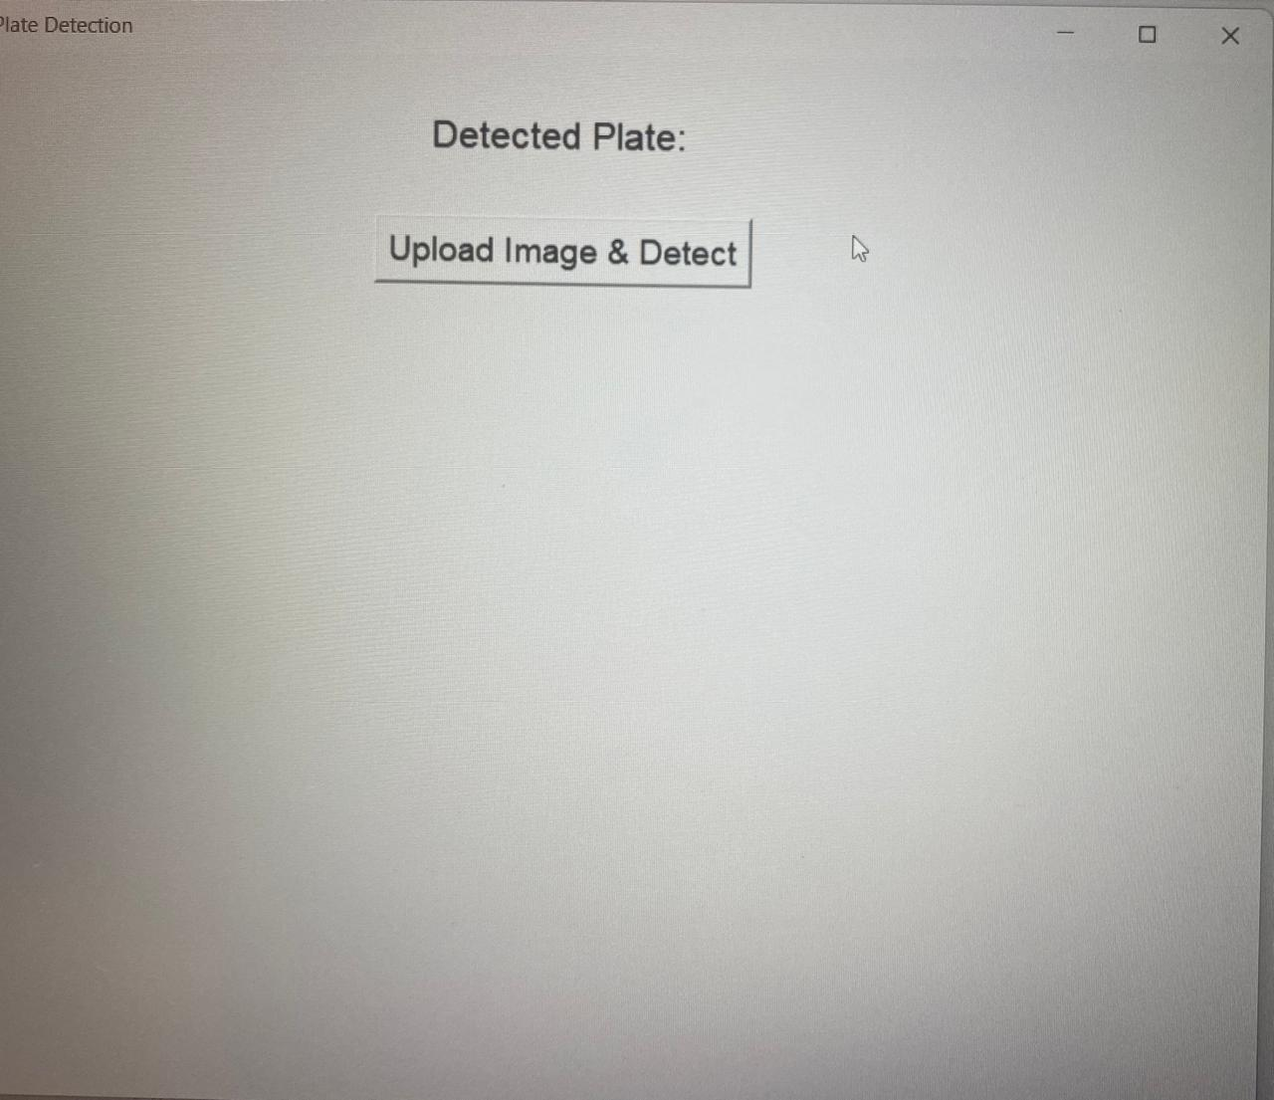
About App..
The License Plate Detection and Recognition Application is a computer vision–based tool designed to automatically identify and extract vehicle license plate numbers from uploaded images. Built using Python, OpenCV, Tkinter, and Tesseract OCR, the application combines image processing and machine learning techniques to provide a seamless and interactive user experience. The process begins when the user uploads an image of a vehicle through the Tkinter interface. The application first applies preprocessing steps, such as grayscale conversion, bilateral filtering, and edge detection, to enhance important details while reducing noise. Contour detection is then performed to locate rectangular shapes in the image, which are further analyzed to identify the license plate region. Once the plate is detected, the application highlights it on the image and crops the relevant area. The cropped region is passed to Tesseract OCR, an open-source text recognition engine, which extracts the alphanumeric characters from the plate. The recognized license number is then displayed clearly within the interface alongside the processed image. This tool can be adapted for multiple real-world use cases, including automated parking systems, traffic surveillance, toll collection, and vehicle tracking. It demonstrates the practical integration of computer vision and OCR in solving everyday challenges in transportation and security.

Slide 7
How do I use the App?

Slide 8
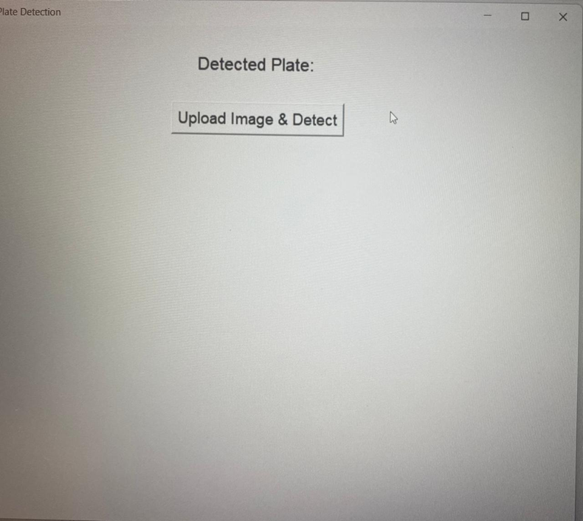
App GUI screen 1

Slide 9
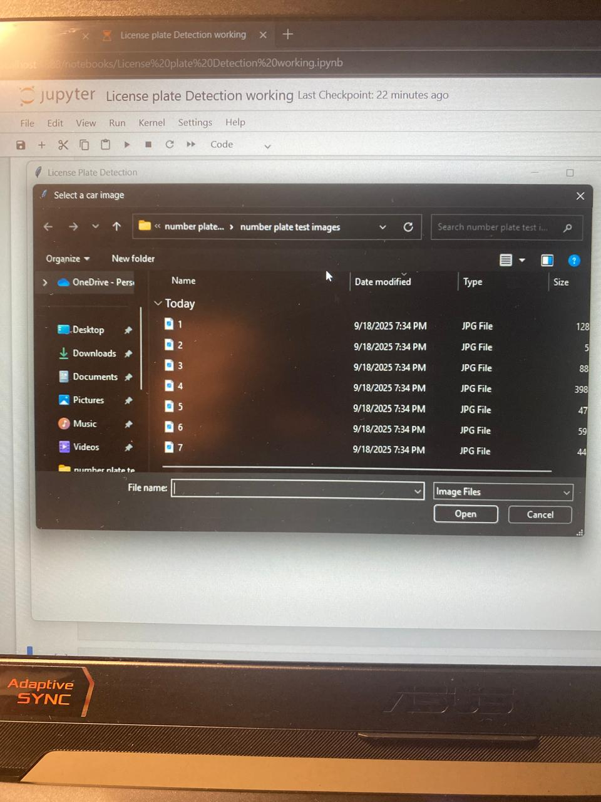
App GUI screen 2

Slide 10
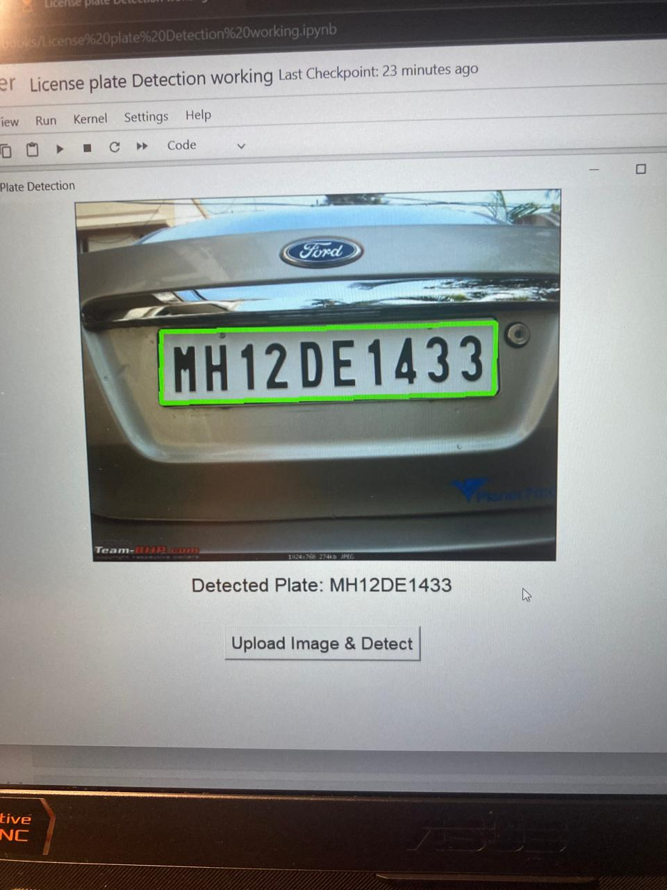
App GUI screen 3

Slide 11
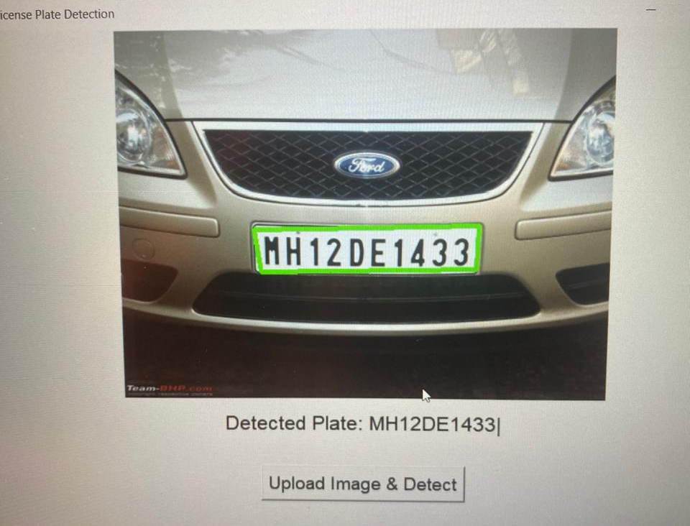
App GUI screen 4

Slide 12
Contact Person
Please reach me out on Prathamprayan@gmail.com for any questions/ concerns/ suggestions on the App

Slide 13
Thank you!

